Slide 1
Backyard birds
By: me
To: whoever receives this.
I don’t care if you read this or not.
P.S.if Mrs. D receives this, she can correct all
The little spelling errors she wants to. :)

Slide 2
Either climbing a tree
or eating bugs, they still remain adorable...
Here Is a list of my top 10 favorite
Backyard birds.
I really hope my brother doesn’t find out about this...

Slide 3
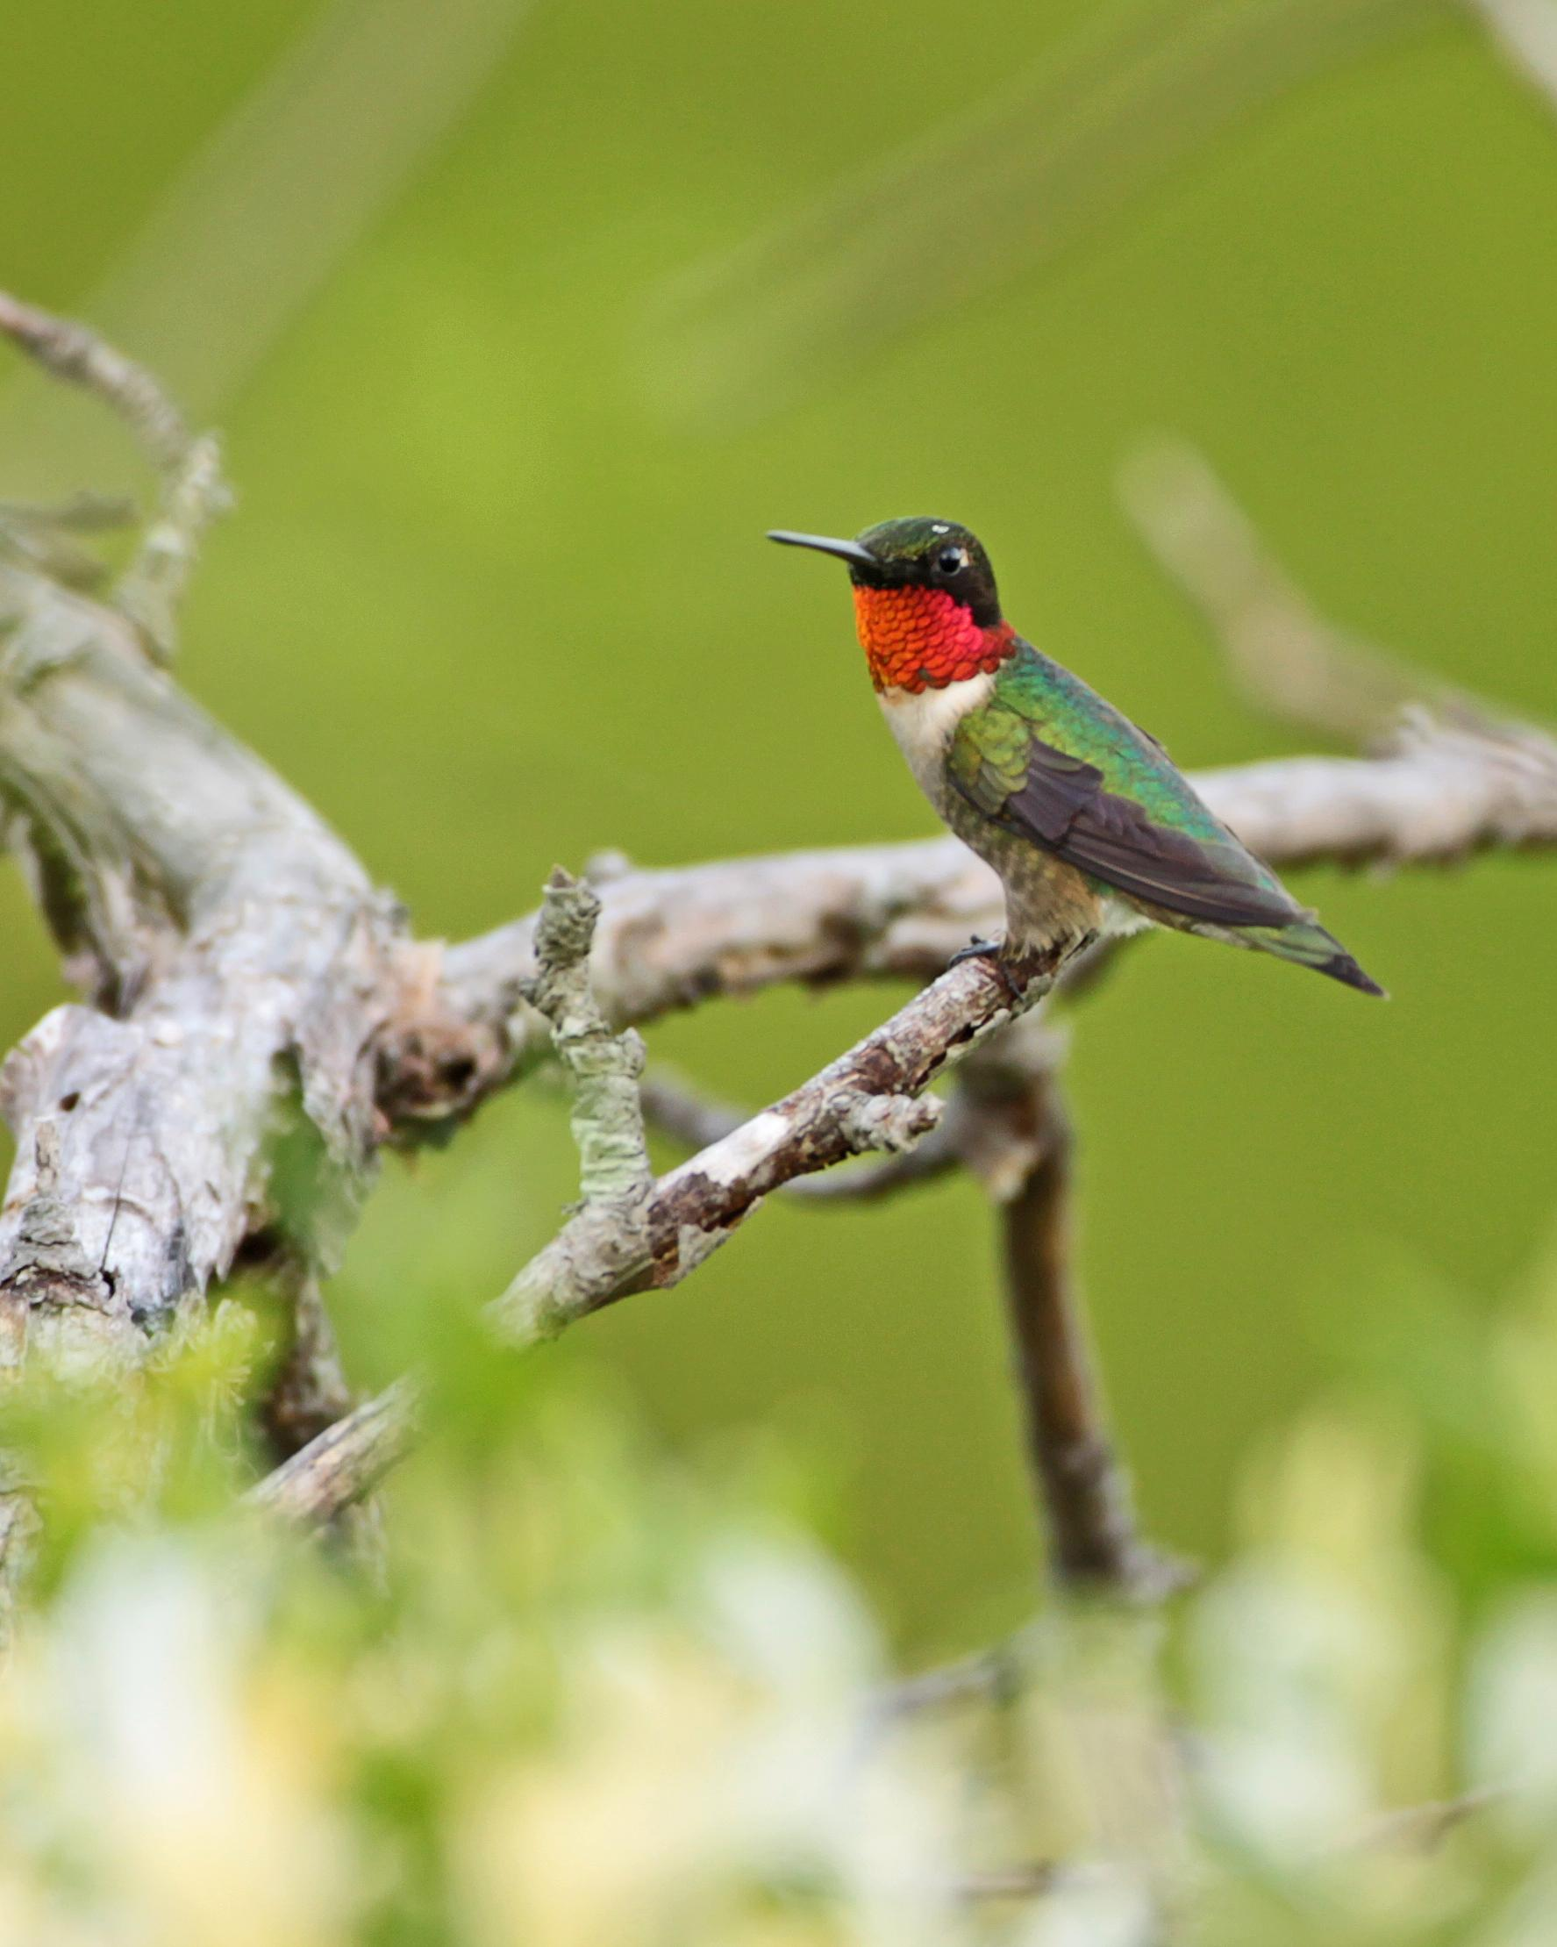
At #10 we have...
RUBY THROATED HUMMINGBIRD:
I like to watch these zip around our yard as
If their houses were on fire,
Hard to find,
But fun to watch!

Slide 4
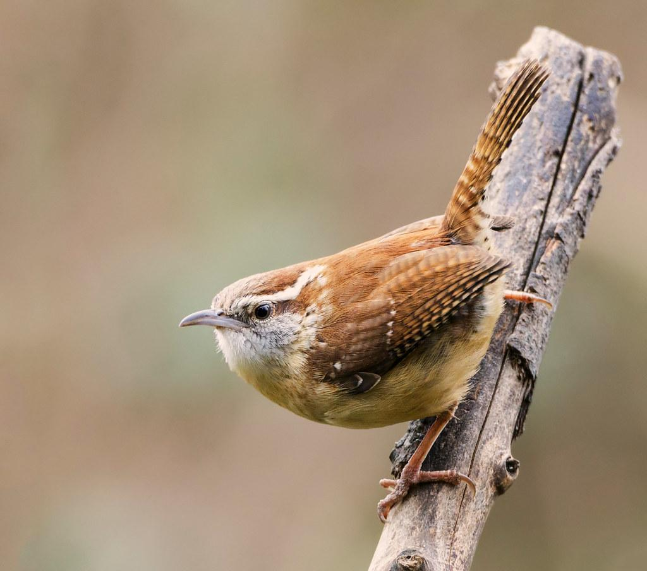
At #9...
CAROLINA WREN:
These birds love to
Do funny things.
One time
One tried to play hide&seek
With me.

Slide 5
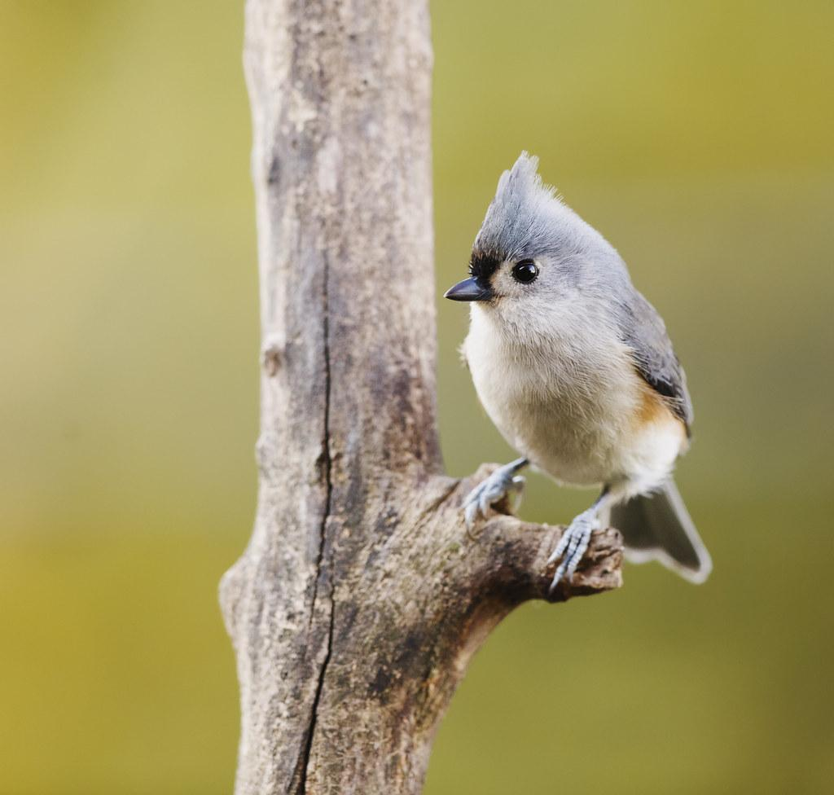
At #8...
TUFTED TITMOUSE:
These birds are natures
Nutcrackers!!
Sure, they’re annoying,
But just look at
That face!
Isn’t he adorible?

Slide 6
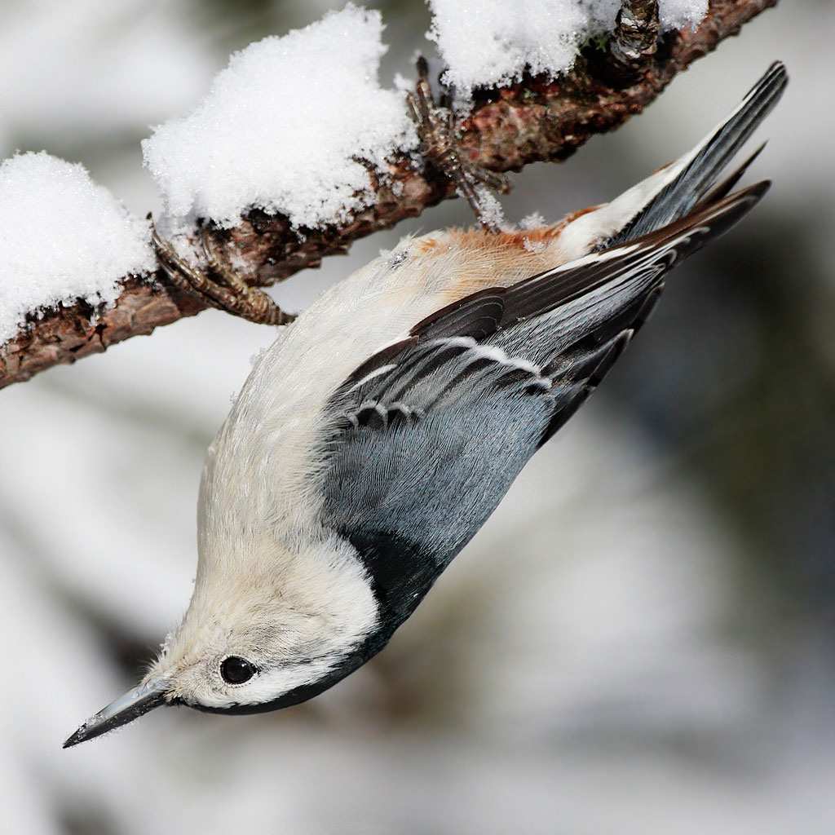
At #7...
WHITE BREASTED NUTHATCH:
It’s my favorite to see them
Climb head-first down trees.
They aren’t woodpeckers,
But are very similar.

Slide 7
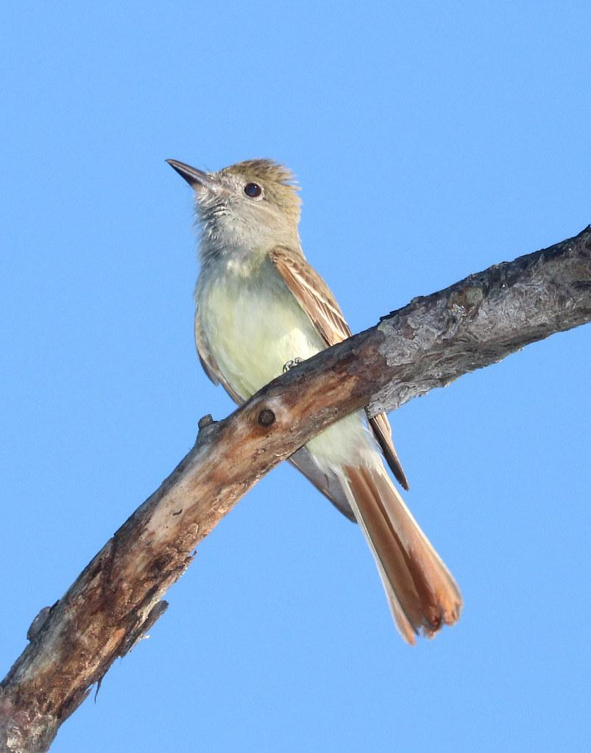
At #6...
GREAT CRESTED FLYCATCHER:
They are only here in the summertime.
I don’t know WHY they like our house
So much.
Don’t they know there
Is a pond right down the road?

Slide 8
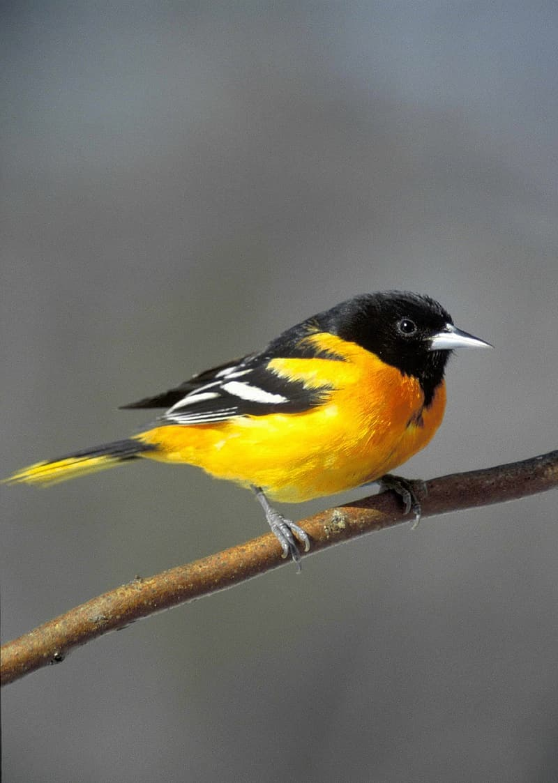
At #5...
BALTIMORE ORIOLE:
This is another summer bird. His favorite
Foods include oranges, apples, peas, nectar,
And even jelly! Just add some bread and
Peanut butter and you got yourself a
Sandwich!

Slide 9
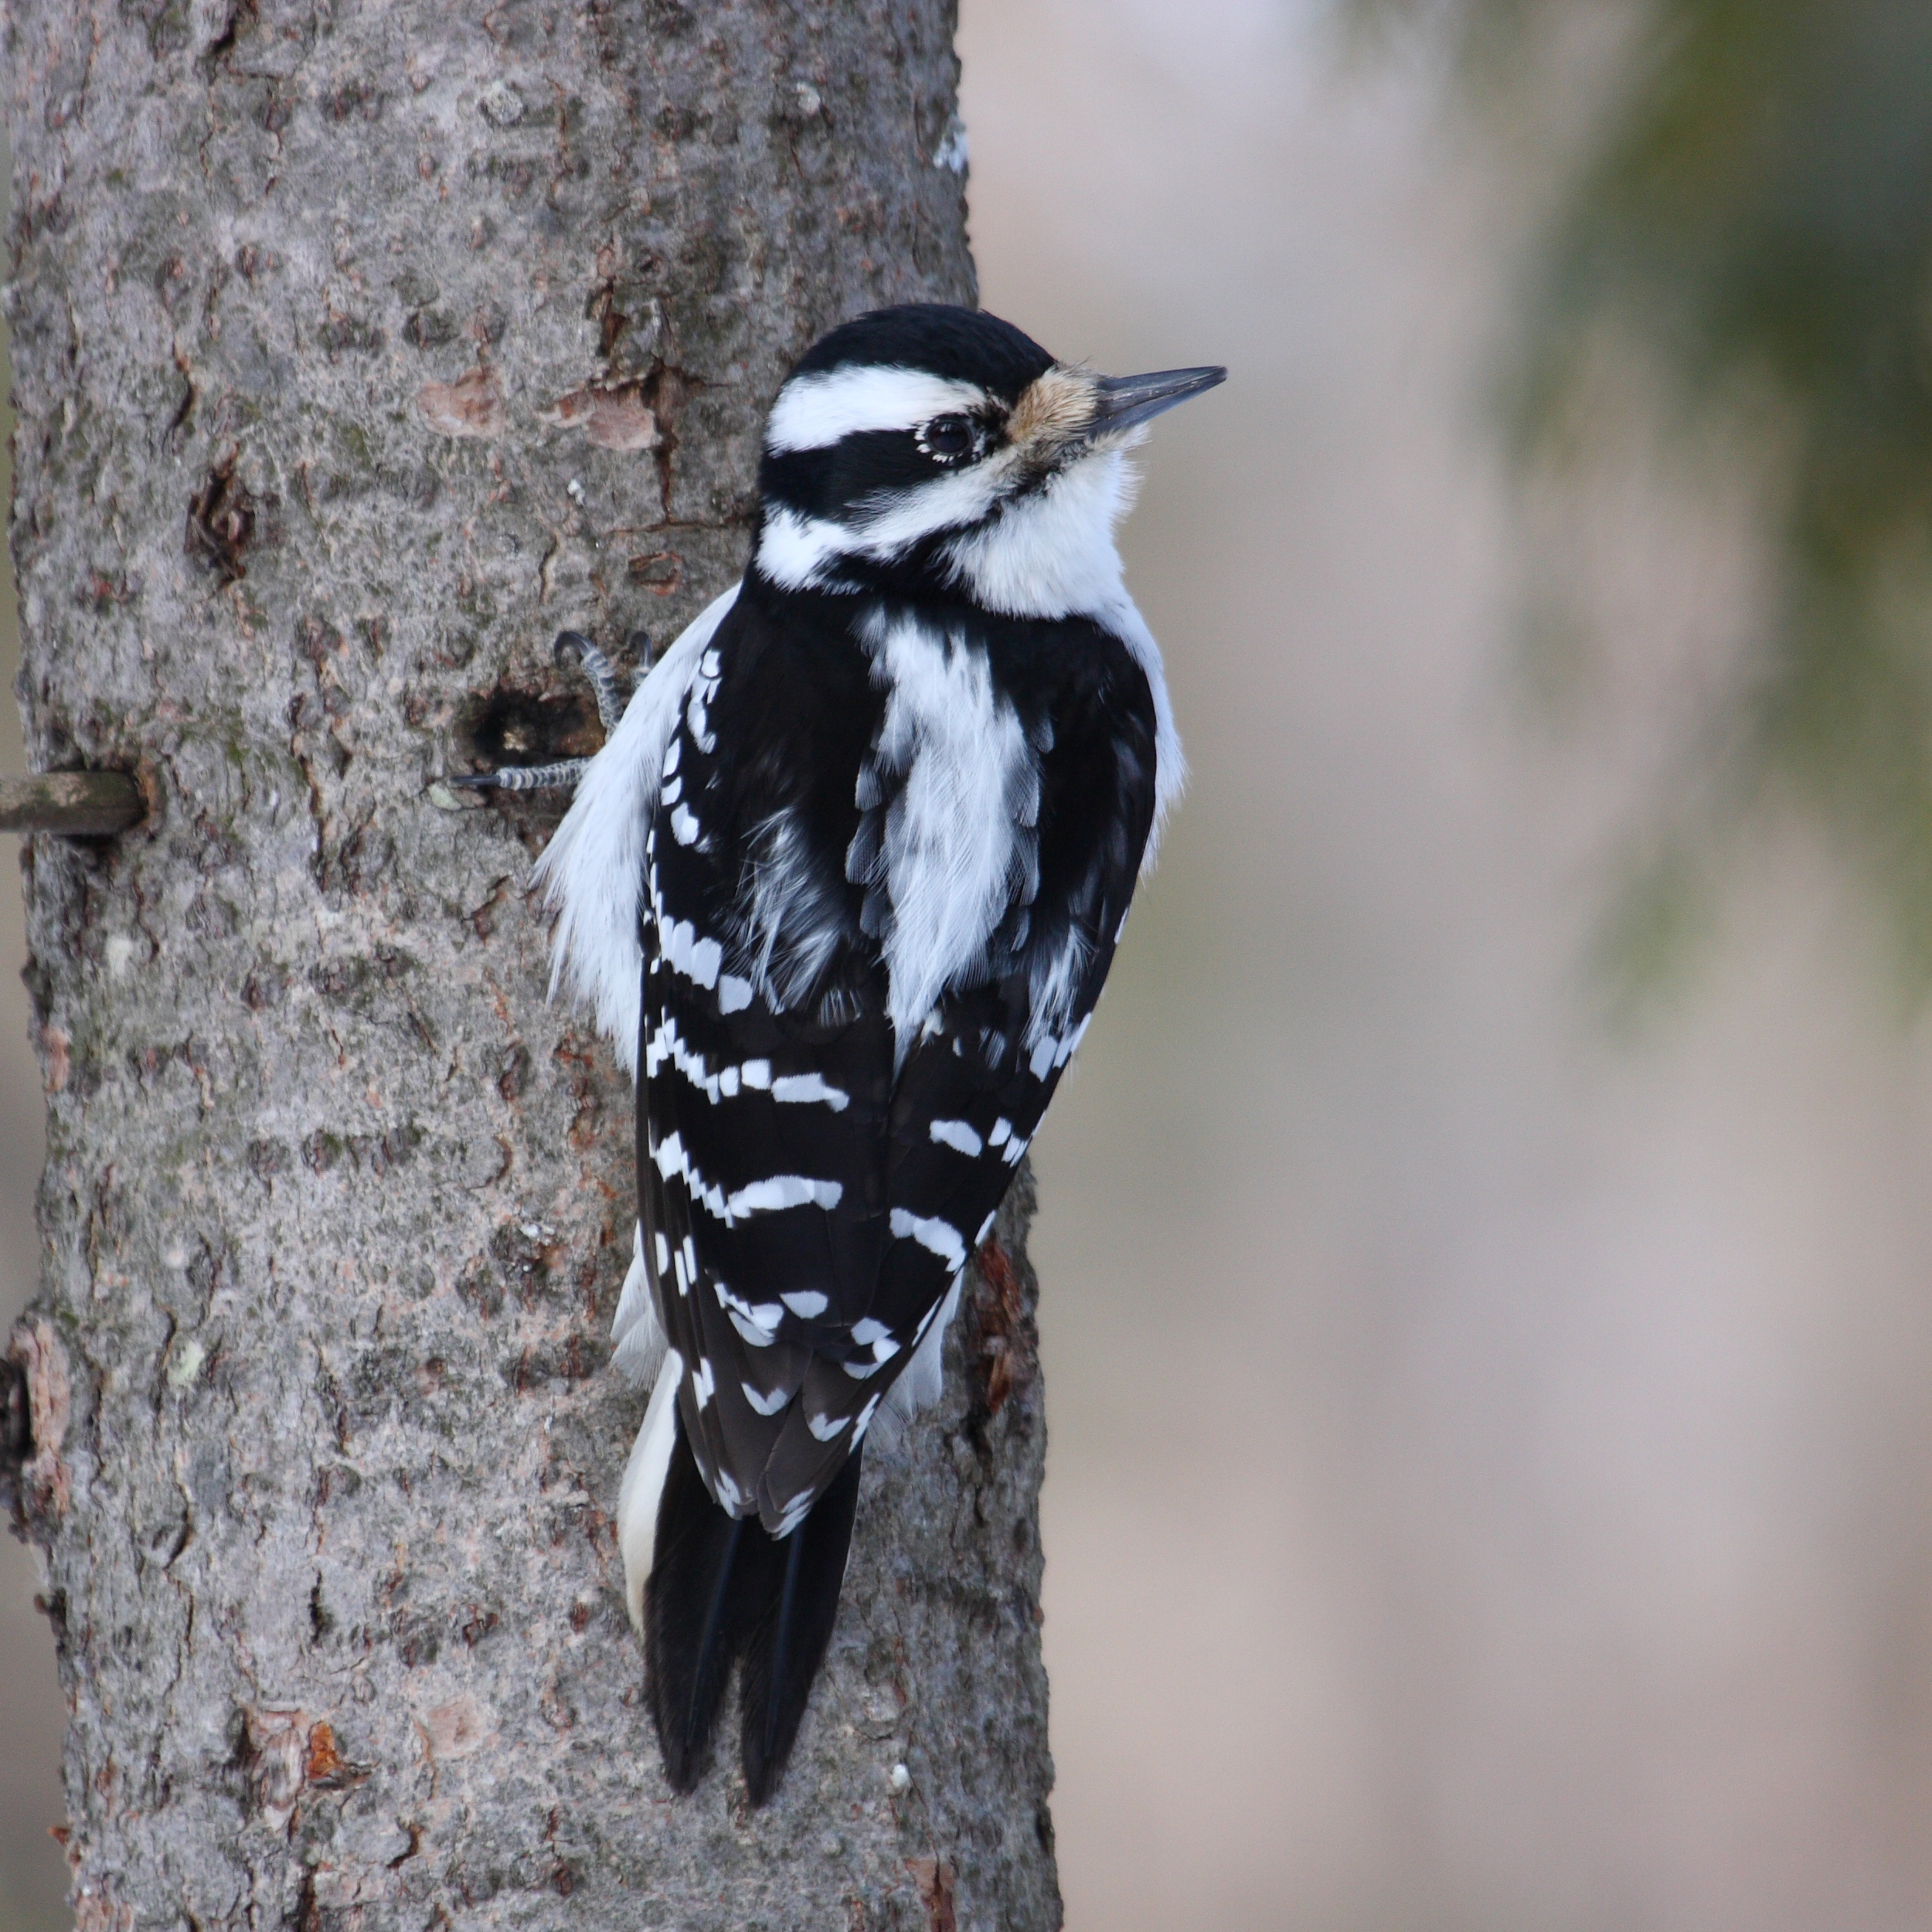
At #4...
HAIRY WOODPECKER:
Harder to find but WE GOT ‘EM!!
You can tell it is a female ‘cuz
It doesn’t look as pretty as the
Male.
They NEVER do.
No offence, ladies!

Slide 10
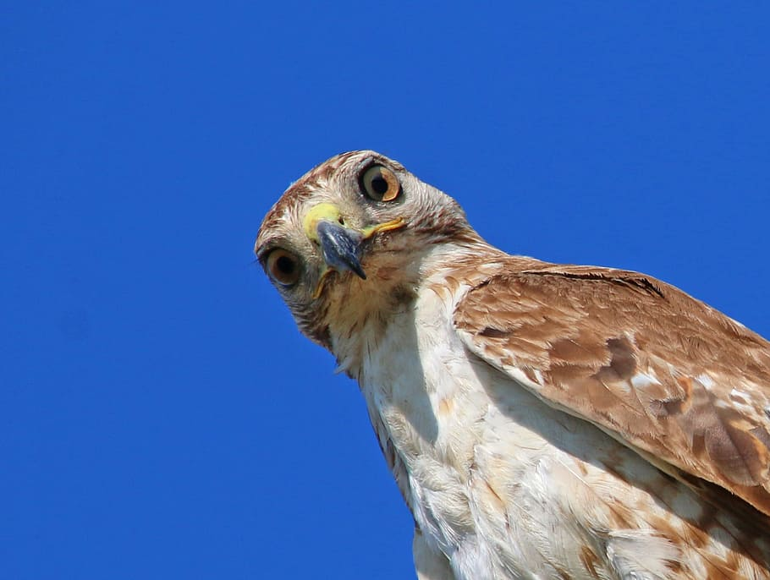
At #3...
RED TAILED HAWK:
Common, but still adorable. I don’t
Know what THIS one is doing.
Why is he
Like that?
Maybe he swallowed a bug.

Slide 11
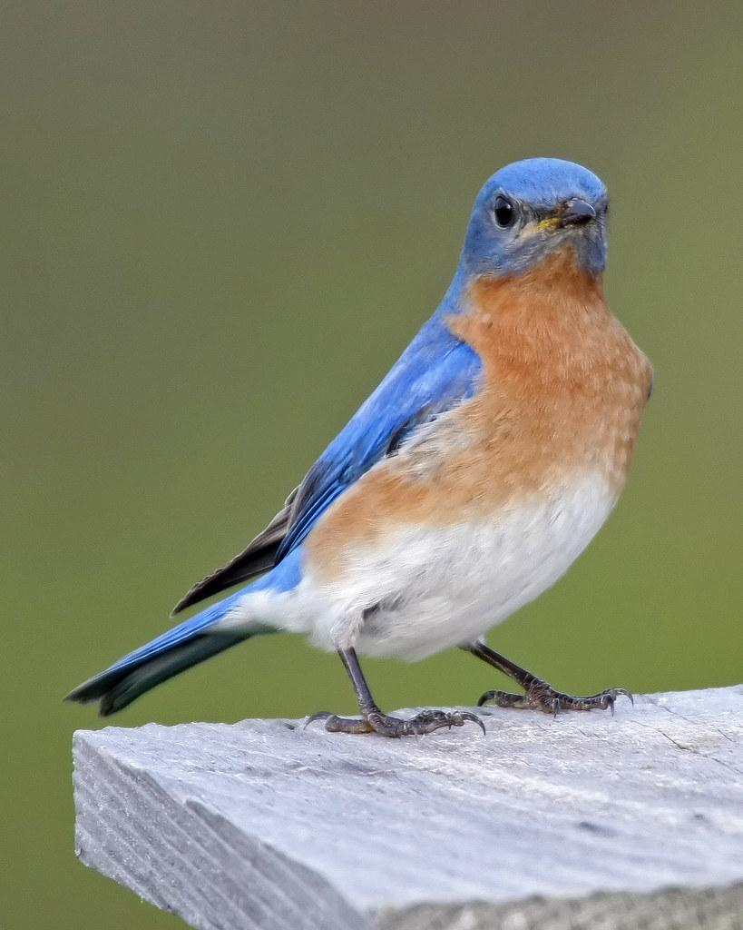
At #2...
EASTERN BLUEBIRD:
Likely our rarest bird we have.
We named him “Stanley”
Just cuz’.

Slide 12
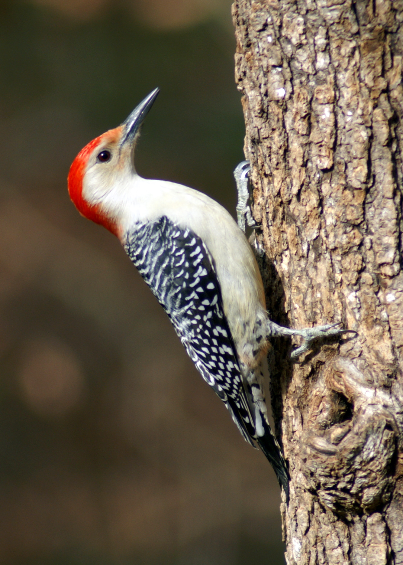
And finally...
#1...
RED BELLIED WOODPECKER:
I LOVE to see them scoot up trees.
It’s as if he
Defies gravity.
Cool, right?
YOU probably WANT
One on YOUR property.
What’s he up to?It looks like he’s pretending to
Moutain climb.

Slide 13
So there...
Now you’re satisfied,right?good.
Type what you thought here
No

